Slide 1
Solving complex linear equations
Solving linear equations

Slide 2
how to use Oak lessons

Slide 3
I can solve complex linear equations, including those involving reciprocals.

Slide 4
An equation is used to show two expressions that are equal to each other.
A rational equation is an equation that contains fractions with unknowns in the numerator, denominator or both.

Slide 5

Solving complex linear equations
Introduction to complex linear equations
Solving complex linear equations
Solving simple rational equations

Slide 6
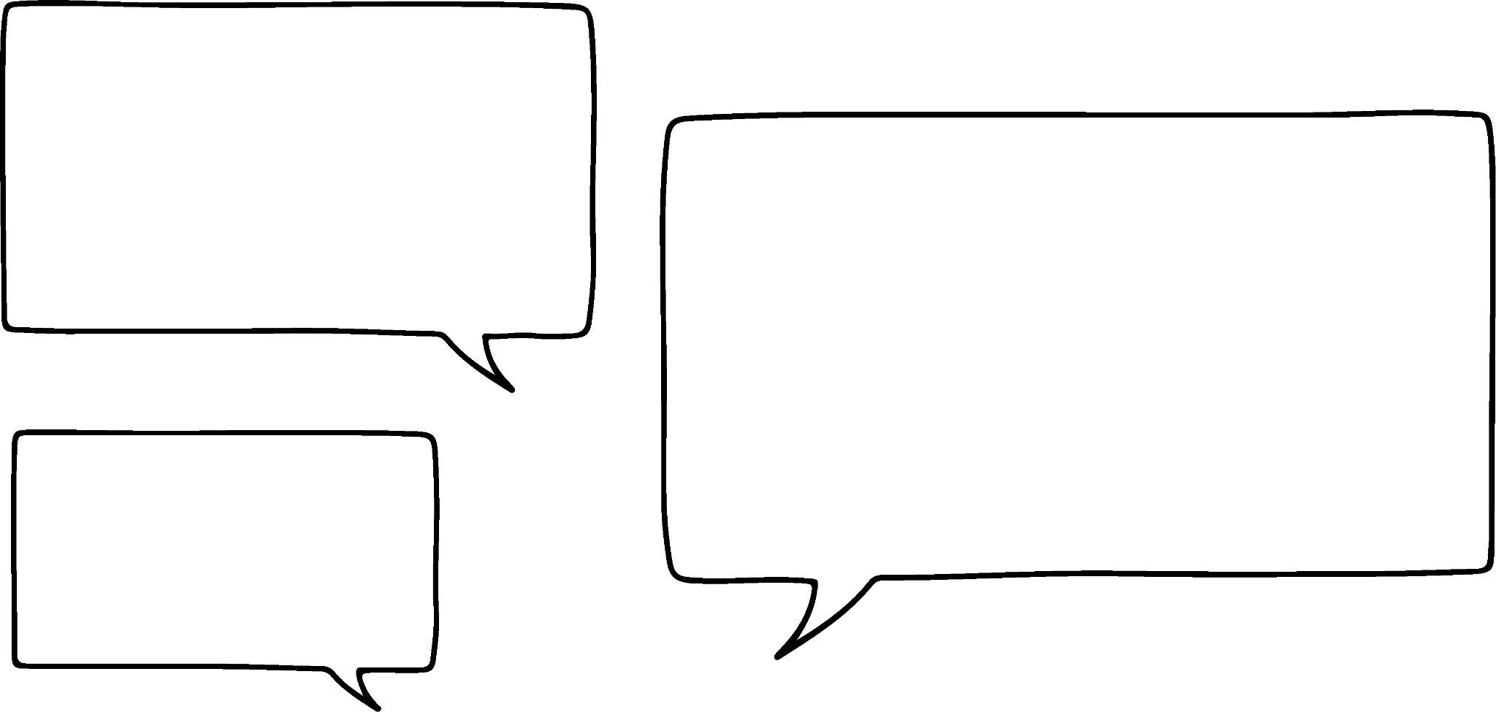
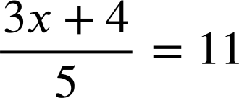
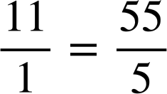


Introduction to complex linear equations
Alex and Izzy are in a lesson on solving linear equations and come across this one.
It’s actually not that bad. Just use this equivalent fraction.
I’m worried. That one looks complex!
Can you see how Izzy’s idea might be useful?
Izzy
Alex

Slide 7
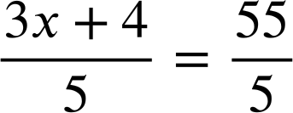
Introduction to complex linear equations
Alex and Izzy are in a lesson on solving linear equations and come across this one.
It’s actually not that bad. Just use this equivalent fraction.
The denominators are now equal therefore the numerators must be. We just solve 3x + 4 = 55
Izzy
Alex

Slide 8
Introduction to complex linear equations
Alex and Izzy are in a lesson on solving linear equations and come across this one.
Izzy’s idea made a complex equation far more simple.
3x + 4 | = | 55
3x | = | 51
x | = | 17
Izzy
Alex

Slide 9
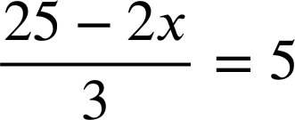
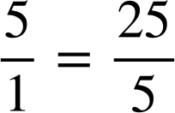

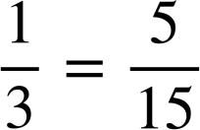
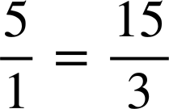

Introduction to complex linear equations
Which equivalent fraction would be useful in solving this equation?
Doesn’t give us equal denominators.
Doesn’t manipulate the 5
The only one which gives us equal denominators, therefore equal numerators.

Slide 10
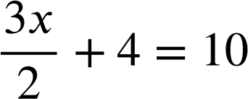
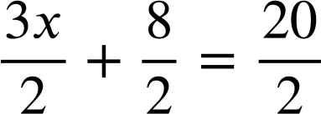
Introduction to complex linear equations
Alex and Izzy now try this equation which looks different again.
I can use equivalent fractions again.
3x + 8 | = | 20
3x | = | 12
x | = | 4
3x + 8 | = | 20
Izzy
Alex

Slide 11
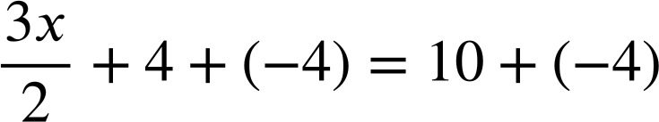
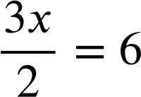
Introduction to complex linear equations
Alex and Izzy now try this equation which looks different again.
That works! But, isn’t it quicker to start like this?
Great idea Alex! That is really efficient.
Izzy
Alex

Slide 12
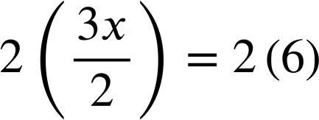
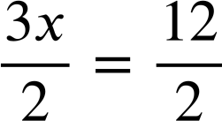
Introduction to complex linear equations
Alex and Izzy now solve but using different methods.
3x | = | 12
x | = | 4
3x | = | 12
x | = | 4
Different methods, same result. Both are fine.
Izzy
Alex

Slide 13
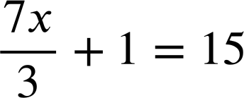
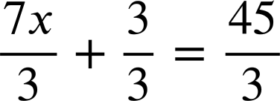
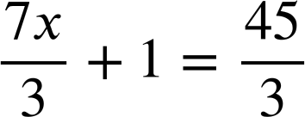
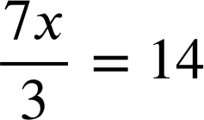
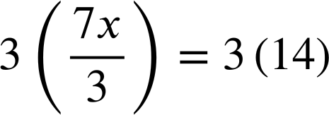
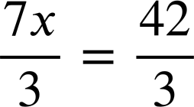
Introduction to complex linear equations
Which would be a useful next step in solving this equation?
Leaves us with 7x + 3 = 45 to solve.
If you went on to solve 7x + 1 = 45 you would not get a correct solution.
Very efficient.
or…
7x = 42
7x = 42

Slide 14
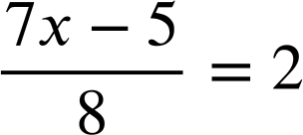
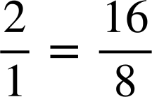
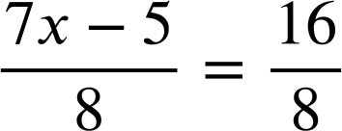
Introduction to complex linear equations
1) Alex solved this complex linear equation. Fill in the missing blanks in his work.
7x − 5 | = | 16
7x | = | 21
x | = | 3

Slide 15
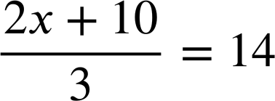
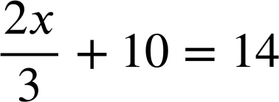
Introduction to complex linear equations
2) Solve:
a)
b)

Slide 16
Introduction to complex linear equations
1) Alex solved this complex linear equation. Fill in the missing blanks in his work.
7x − 5 | = | 16
7x | = | 21
x | = | 3

Slide 17
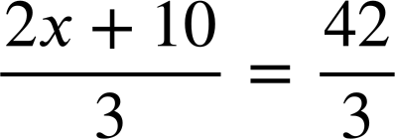
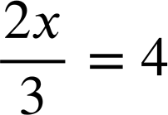
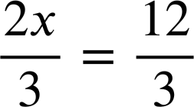
Introduction to complex linear equations
2) Solve:
a)
b)
2x + 10 | = | 42
2x | = | 32
x | = | 16
2x | = | 12
x | = | 6

Slide 18
Solving complex linear equations
Introduction to complex linear equations
Solving complex linear equations
Solving simple rational equations

Slide 19
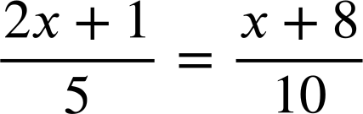
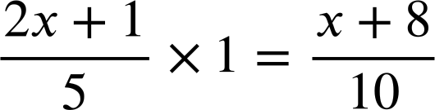
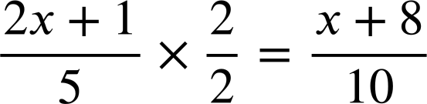
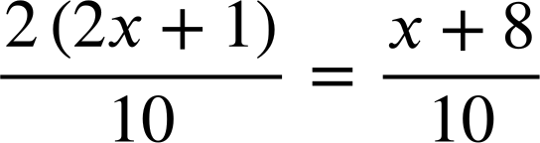
Solving complex linear equations
Sometimes we have a fraction on both sides of the equation.
2(2x + 1) | = | x + 8
4x + 2 | = | x + 8
3x + 2 | = | 8
3x | = | 6
x | = | 2
2(2x + 1) | = | x + 8
2(2x + 1) | = | x + 8
4x + 2 | = | x + 8
Now we have equal denominators.

Slide 20
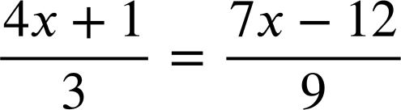

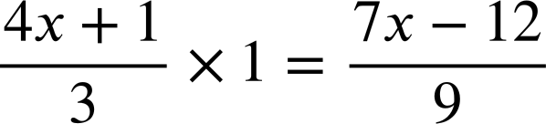

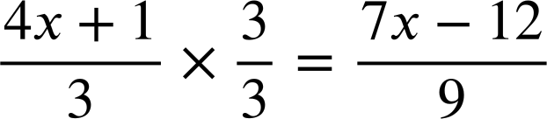

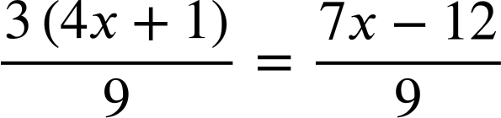
Solving complex linear equations
Which equivalent fraction to 1 should be used in solving this equation?
The only one that gives us equal denominators.
3(4x + 1) = 7x − 12 can be solved.

Slide 21
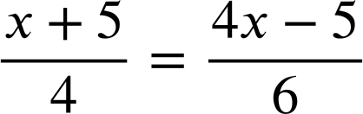
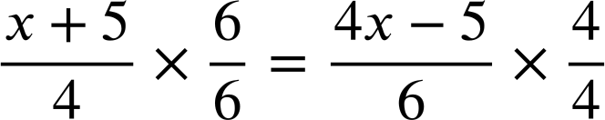
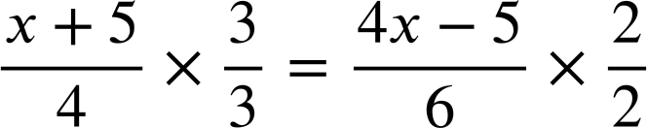


Solving complex linear equations
Sometimes we have to manipulate both fractions.
We need equal denominators and 4 × 6 = 24 so I’m going to start like this.
The LCM of 4 and 6 is 12 so I’m going to start like this.
Who is right?
Jacob
Both will work.
Aisha

Slide 22
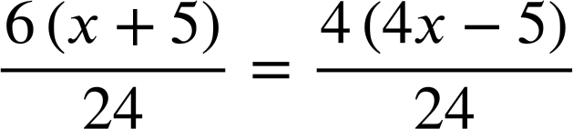
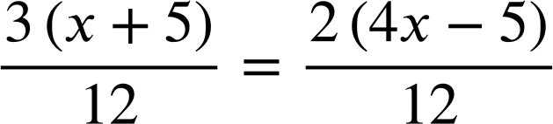
Solving complex linear equations
Sometimes we have to manipulate both fractions.
6(x + 5) = 4(4x − 5)
3(x + 5) = 2(4x − 5)
3x + 15 = 8x − 10
Both methods work but,
Aisha’s is slightly more efficient.
Jacob
x = 5
Aisha

Slide 23
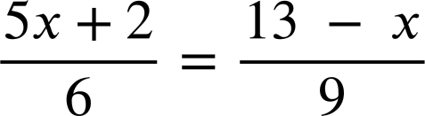
Solving complex linear equations
To solve this equation we need only manipulate the fraction on the LHS.
We need equal denominators and 6 is not a factor of 9
6 × 9 = 54 so we should make the denominators 54
We need equal denominators and 6 is not a factor of 9 The LCM of 6 and 9 is 18 so we should use that.

Slide 24
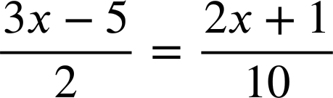
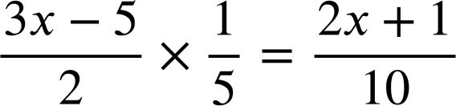
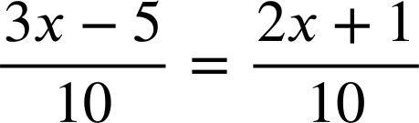
Solving complex linear equations
1) Where is the error in this attempted solution? Find the error and write a sentence explaining why it is wrong.
3x − 5 = 2x + 1
x − 5 = 1
x = 6

Slide 25
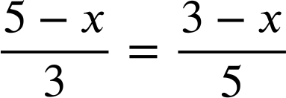
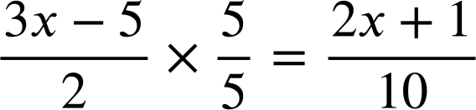
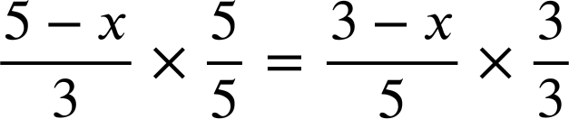
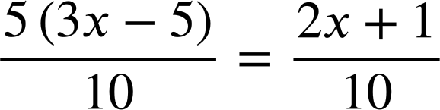
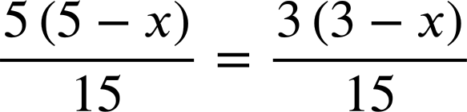
Solving complex linear equations
2) Aisha successfully solved two equations. Fill in the missing blanks in her working.
5(3x − 5) = 2x + 1
5(5 − x) = 3(3 − x)
15x − 25 = 2x + 1
25 − 5x = 9 − 3x
13x = 26
16 = 2x
x = 2
x = 8

Slide 26
Solving complex linear equations
1) Where is the error in this attempted solution? Find the error and write a sentence explaining why it is wrong.
Multiplying the LHS by a fifth and not doing the same to the RHS means our equation has lost equality at this point.
3x − 5 = 2x + 1
x − 5 = 1
x = 6

Slide 27
Solving complex linear equations
2) Aisha successfully solved two equations. Fill in the missing blanks in her working.
5(3x − 5) = 2x + 1
5(5 − x) = 3(3 − x)
15x − 25 = 2x + 1
25 − 5x = 9 − 3x
13x = 26
16 = 2x
x = 2
x = 8

Slide 28
Solving complex linear equations
Introduction to complex linear equations
Solving complex linear equations
Solving simple rational equations

Slide 29




Solving simple rational equations
Jun and Sofia are discussing this equation.
I see this as x ÷ 10 = 2 so I know x = 20 but how do I write that using notation?
x = 20
I start by writing the multiplicative inverse of the denominator.
I see. You had x ÷ 10 and you multiplied it by 10 to leave you with just x

Slide 30

Solving simple rational equations
Jun and Sofia now try this equation.
But I am very stuck on this one. It looks strange! I’ve never seen an unknown as a denominator before.
Isn’t the multiplicative inverse of ÷ x going to be × x ?
What do you think? Would Jun’s idea work?

Slide 31

Solving simple rational equations
Jun and Sofia now try this equation.
10 ÷ x × x = 10
Isn’t the multiplicative inverse of ÷ x going to be × x ?
10 = 2x
x = 5
Yes, Jun! That works! 10 ÷ 5 = 2

Slide 32





Solving simple rational equations
Solve:
7y = 35
4 = 33x
y = 5

Slide 33





Solving simple rational equations
Solve:
Solve:
7y = 35
4 = 33x
48 = 8d
5 = 18e
y = 5
d = 6

Slide 34
Solving simple rational equations
Like many parts of maths there are multiple ways to solve rational equations.
The multiplicative inverse of the denominator.
7y = 35
y = 5

Slide 35


Solving simple rational equations
Like many parts of maths there are multiple ways to solve rational equations.
Alternatively, multiply by 1
7y = 35
Equal denominators, equal numerators.
y = 5
7y = 35
Different methods, same result.
y = 5

Slide 36








Solving simple rational equations
Solve:
Solve:
−19y = 2
3 = −8x

Slide 37






Solving simple rational equations
Solve:
Solve:
3(y + 4) = 15
6(y − 3) = 24
y + 4 = 5
y − 3 = 4
y = 1
y = 7

Slide 38



Solving simple rational equations
1) Finish each method to solve this equation in two different ways:

Slide 39



Solving simple rational equations
2) Solve:
a)
b)
c)

Slide 40

Solving simple rational equations
1) Finish each method to solve this equation in two different ways:
54 = 6e
e = 9
54 = 6e
e = 9

Slide 41






Solving simple rational equations
2) Solve:
a)
b)
c)
11x = 84
84 = 12x
−21x = 84
x = −4
x = 7

Slide 42
Solving complex linear equations
Complex linear equations, even those including reciprocals, can be manipulated and solved using our knowledge of manipulating fractions.

Slide 43

© Oak National Academy 2023.
Produced in partnership with Mathematics in Education and Industry.
Licensed on the Open Government Licence v3.0, except where otherwise stated. See Oak terms and conditions.

